Slide 1
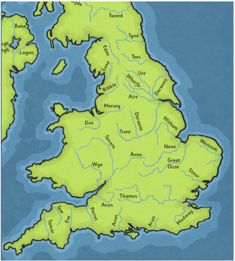
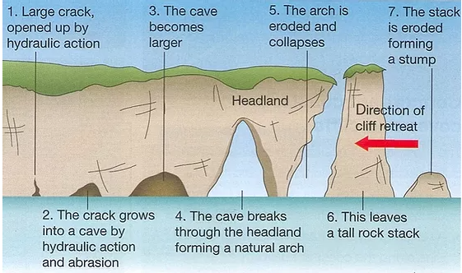
Geography Unit: Our Changing World
Rivers and Coasts
Summer 2
Year 6
Core Learning of this unit: Locate geographical regions and their identifying human and physical characteristics, key topographical features (coasts and rivers), and land-use patterns; and understand how some of these aspects have changed over time. Use maps, atlases, globes and digital/computer mapping to locate countries and describe features studied Use fieldwork to observe, measure, record and present the human and physical features in the local area.
Vocabulary | Definition
Source | The point at which a river starts.
Tributaries | Small streams that join the larger river.
Erosion | The wearing away of rock along the coastline.
Deposition | Material is ‘dropped’ or deposited.
Meander | The natural bend in a river.
Oxbow lake | A section of a meander that becomes isolated from the main river channel and eventually dries out.
Mouth | The point where the river ends.
Headland | a part of the coastline that juts out into the sea and usually ends in a cliff.
Landslide | the downward sliding of a large mass of earth and rock
Longshore drift | the process whereby beach material is gradually shifted along a beach by waves meeting the shore at an oblique angle.
Stacks | a detached pillar of rock on a sea coast separated from the mainland by erosion.
Arches | a coastal feature formed when waves erode through a headland.
Key Facts
The longest river in the world is the River Nile (6,695 km long)
The longest river in the United Kingdom is the River Severn (354 km long)
The coast is where land meets the sea.
Coastal erosion is the loss or displacement of land, or the long-term removal of sediment and rocks along the coastline due to the action of waves, currents and tides.
Waves erode softer rock on the coast into bays, leaving headlands of harder rock protruding into the sea.
Human features can contribute to erosion on the coast. Buildings on cliff tops can increase the instability of cliffs, resulting in landslips.
Prior Learning
Year 4
Water, Water (The water cycle and Rivers)

