Slide 1
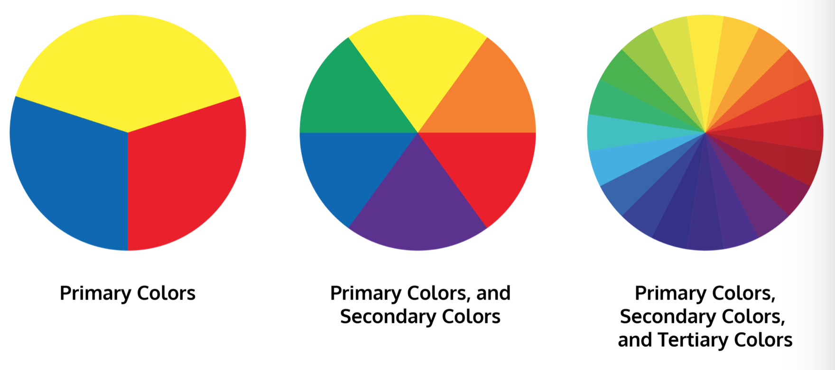
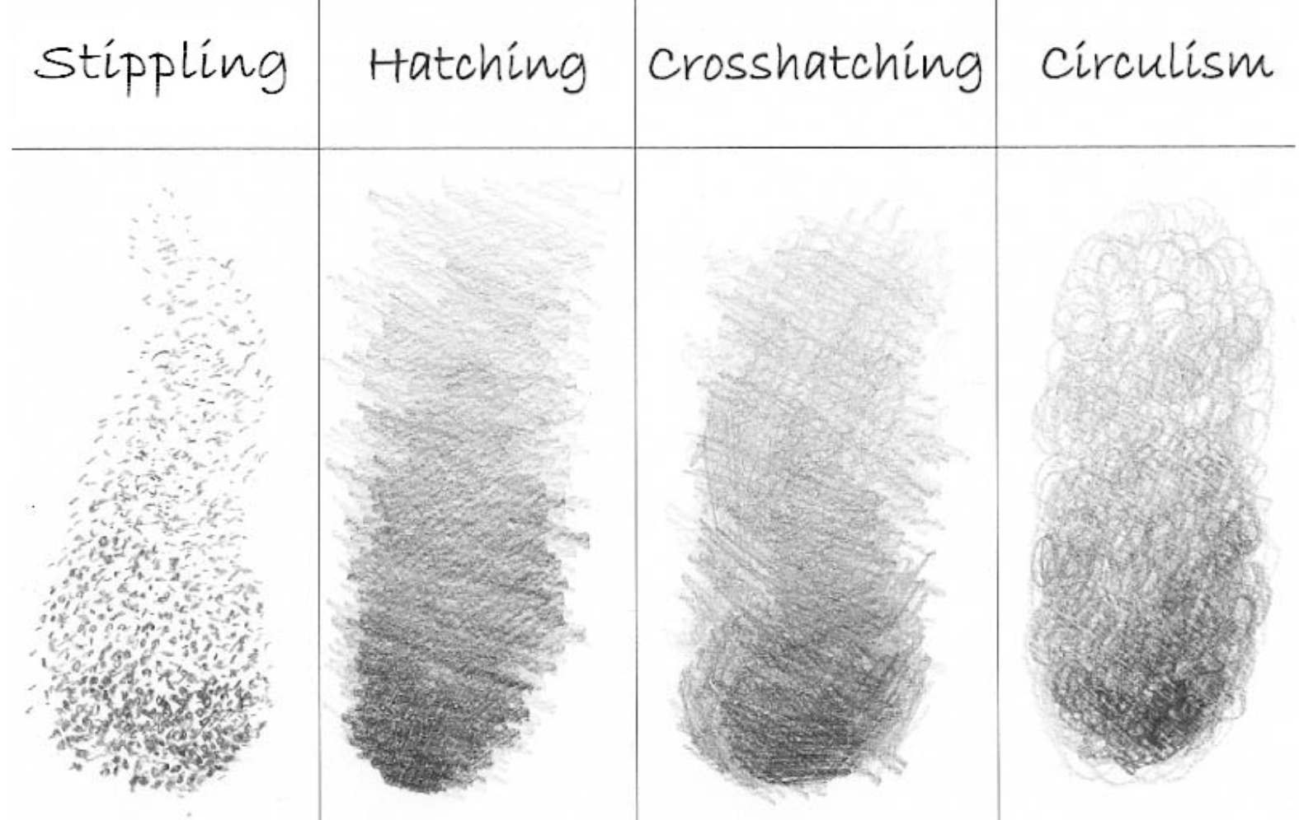
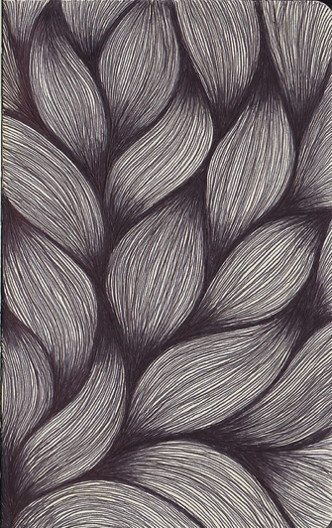
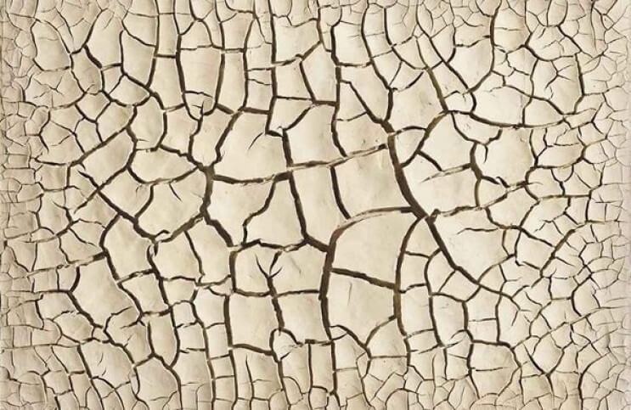
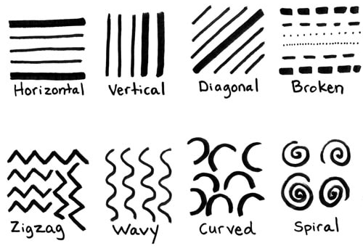
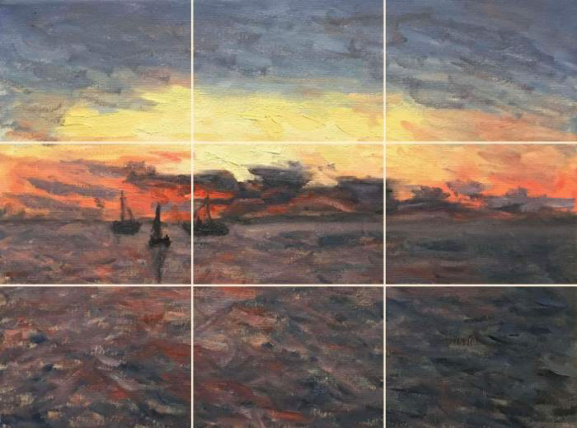
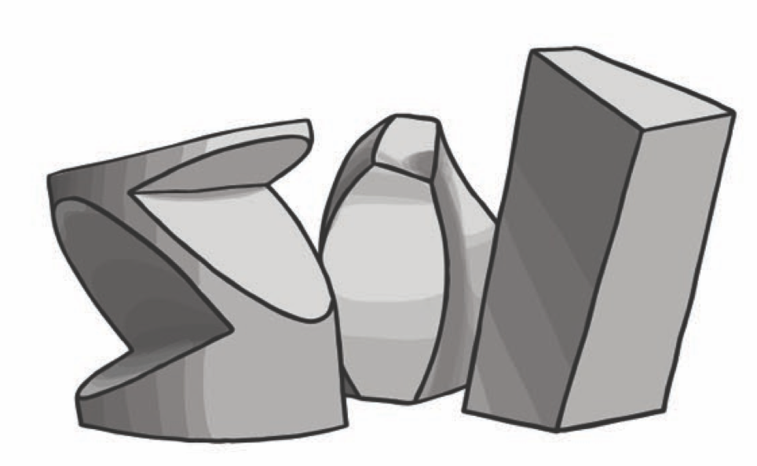
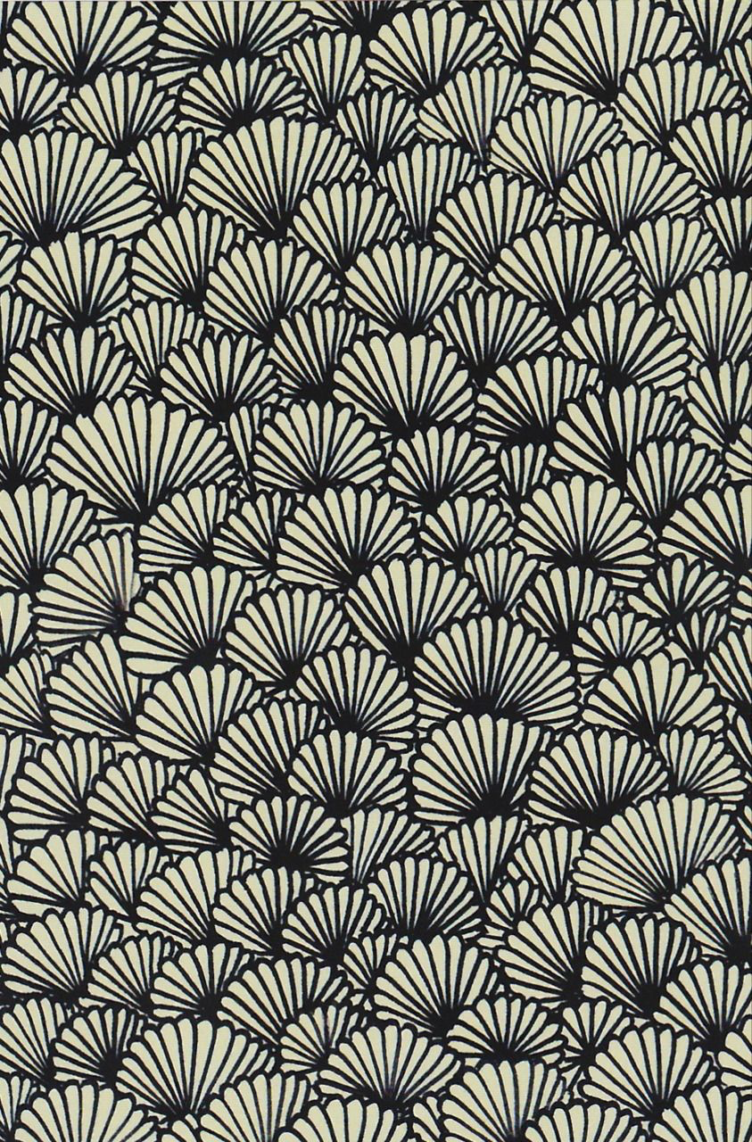
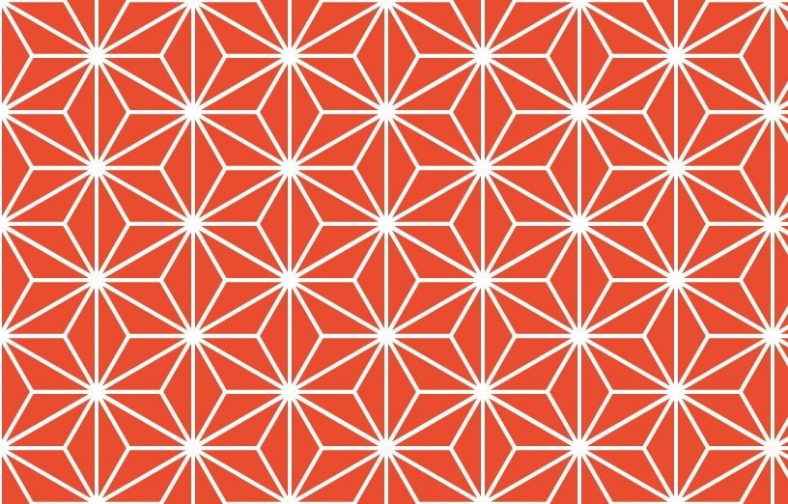
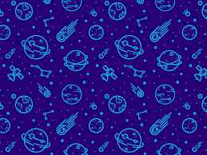
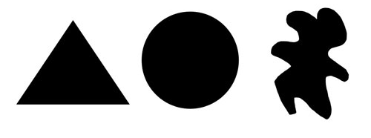
Eight Elements of Art
Colour
There are 3 primary colours: red, yellow and blue. By mixing any 2 primary colours together we get secondary colours.
Tone
Different degrees of lightness and darkness. You can use a pencil to shade or make colours lighter or darker. This makes objects look real and solid.
Texture
How the surface of something feels.
Line
A single long mark made by an implement.
Composition
Is the placement of visual elements.
Form
The 3 dimensional shape.
Pattern
When shapes, colours or lines are repeated it is a pattern.
Shape
The outline or form of something.

