Slide 1
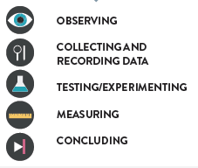
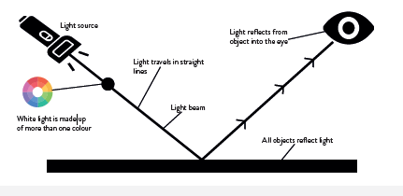
Light and Shadow
Science Unit: How we See
Autumn 2
Year 6
Core Learning of this unit: Recognise that light appears to travel in straight lines. Use the idea that light travels in straight lines to explain that objects are seen because they give out or reflect light into the eye. Explain that we see things because the light that travels from light sources to our eyes or from light sources to objects and then to our eyes. Use the idea that light travels in straight lines to explain why shadows have the same shape as the objects that cast them.
Vocabulary | Definition
Cornea | the outer clear covering over the eye.
Iris | the coloured part of the eye.
Pupil | the black hole in the centre of the iris that lets light into the eye.
Retina | a light-sensitive inner lining at the back of the eye.
Lens | the part of the eye that focuses the light.
Optic Nerve | takes signals from the retina and carries them all the way to the back of the brain.
Light Source | natural (eg the sun) or artificial (eg a light bulb) provider of light.
Reflection | the throwing back by a body or surface of light, heat or sound without absorbing it.
Shadow | a dark area or shape produced by a body coming between rays of light and a surface.
Transparent | allowing light to pass through.
Translucent | partly allowing light to pass through
Opaque | not allowing light to pass through.
Periscope | an apparatus consisting of a tube attached to a set of mirrors or prisms through which an observer can see things that are otherwise out of sight.
Working Scientifically
Prior Learning
Year 3
Light and Shadow
How we See
The Eye

