Slide 1
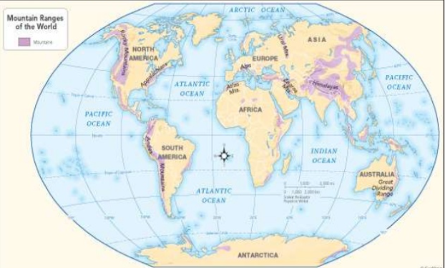
Geography Unit: Mountains and Volcanoes
Spring 1
Year 6
Core Learning of this unit: Locational knowledge -name and locate the world’s mountains, volcanoes and earthquakes, concentrating on their key human and physical characteristics. Place knowledge -understanding geographical similarities and differences between the UK, Europe and North and South America. Physical geography -describe and understand key aspects of mountains volcanoes and earthquakes. Human geography-describe and understand key aspects of types of settlement and land use. Geographical skills and fieldwork- use maps and digital/computer mapping to locate countries and describe features studied.
Vocabulary | Definition
Altitude | The distance above sea level.
Avalanche | A mass of snow, rock, ice and soil that tumbles down a mountain.
Summit | The highest point of a mountain.
Fold | Mountains that are formed where two or more of the earths tectonic plates are pushed together
Fault-block | These mountains are formed when faults or cracks in the earths crust force materials or blocks of rock up and others down.
Dome | Mountains created as a result of a great amount of melted rock (magma) pushing its way up under the earths crust without erupting.
Crevasse | A deep open crack in the terrain, especially one in a mountain or glacier.
Range | a series of mountains close together.
Tectonic plates | Pieces of the rocky outer layer of the Earth known as the crust.
Contour | Lines found on maps that show high or low areas of land.
Ridge | The edge formed where the two sloping sides of the mountain meet.
Ravine | A deep, narrow gorge with steep sides.
Key Facts
Mountains are found in every continent of the world, even Antarctica, over millions of years.
Some mountains are isolated features but most are found in mountain ranges such as the Himalayas, the Alps, the Rockies and the Urals.
Volcanoes are mountains. They differ from other mountains in being formed by ash, lavas, or volcanic ‘bombs’ thrown out of the mouth of the volcano.
Mountains are important economically: mining, quarrying, timber and tourism provide a living for local people.
Mountains are constantly being eroded by a variety of processes including weathering by ice, snow, rain and wind.
Prior Learning
Year 3
Rock and Roll
Earthquakes and Volcanoes
Fold Mountains
Fault-block Mountains
Dome Mountains
Volcanic Mountains

