Slide 1
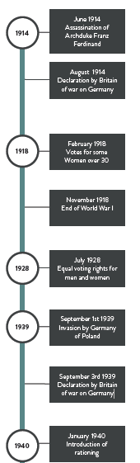
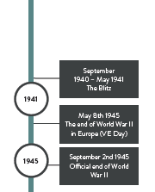
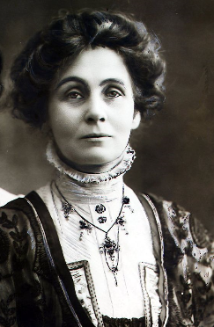
War and Conflict In Britain
Autumn 2
Year 6
Historical Facts In 1918, some women over the age of 30 gained the right to vote. The Second World War, was a global war that lasted from 1939 to 1945. It involved the vast majority of the world's countries From the start of World War II in September 1939, the government started to move children out of Liverpool and other major UK cities for their safety. The Blitz was the German bombing campaign on UK cities from September 1940-May 1941. Liverpool was the most heavily bombed area of the country, outside London, due to the city having, along with Birkenhead, the largest port on the west coast and being of significant importance to the British war effort.
Vocabulary | Definition
Suffragette | a member of militant women's organisations in the early 20th century who fought for the right to vote in public elections.
Blitz | comes from the German word blitzkrieg, meaning ‘lightning war’.
Campaigned | work in an organized and active way towards a particular goal
Rationing | the controlled distribution of scarce resources, goods
Parliament | the highest legislature, consisting of the Sovereign, the House of Lords, and the House of Commons.
Propaganda | information, especially of a biased or misleading nature, used to promote a political cause or point of view.
Activist | a person who campaigns to bring about political or social change
Evacuee | A person evacuated (taken away) from a place of danger
Sources | A primary source provides direct or first-hand evidence about an event, object, person, or work of art. Secondary sources are not first-hand.
Air Raid | an attack in which bombs are dropped from aircraft on to a ground target.
Siren | a device that makes a loud prolonged signal or warning sound.
Luftwaffe | The German air force.
Significant People Emmeline Pankhurst was a British political activist. She is best remembered for organising the UK suffragette movement and helping women win the right to vote. In 1914, during WW1, Emmeline Pankhurst encouraged members to put their demonstrations on hold, in order to focus on the war effort.

