Slide 1
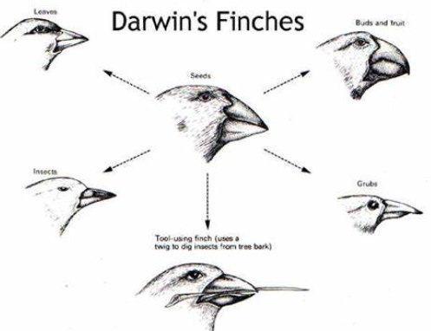
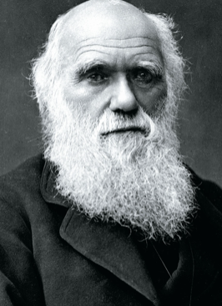
Survival
Science Unit: Evolution and Inheritance
Autumn 1
Year 6
Core Learning of this unit: Recognise that living things have changed over time and that fossils provide information about living things that inhabited the Earth millions of years ago. Recognise that living things produce offspring of the same kind, but normally offspring vary and are not identical to their parents. Identify how animals and plants are adapted to suit their environment in different ways and that adaptation may lead to evolution.
Vocabulary | Definition
Fossils | The remains or traces of plants and animals that lived long ago.
Offspring | The young born of living organisms.
Adaption | When an animal adapts (makes changes) to fit/survive in its environment.
Evolution | The theory that all the kinds of living things that exist today developed from earlier types.
Inheritance | Characteristics that are passed on from parents to offspring.
Species | A species is a group of animals, plants or other living things that all share common characteristics.
Reproduce | A living organism creates a likeness of itself.
Characteristic | A physical feature serving to identify an animal.
Variation | A change or slight difference.
Breeding | The mating and production of offspring by animals
Working Scientifically
Observing and raising questions about local animals and how they are adapted to the environment.
Comparing how some living things are adapted to survive in extreme conditions, for example cactuses, penguins and camels.
By analysing the advantages and disadvantages of specific adaptations, such as being on two feet rather than four, having a long or a short beak, having gills or lungs, tendrils on climbing plants, brightly coloured and scented flowers.
Prior Learning:
Year 2 Year 3
Reproduction and Growth Rocks (Fossils)
Year 4
Living Things and Habitats
Significant People Charles Robert Darwin was an English naturalist, geologist and biologist, best known for his contributions to the science of evolution. His proposition that all species of life have descended over time from common ancestors is now widely accepted, and considered a foundational concept in science.

