Slide 1
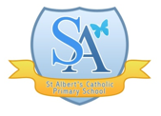
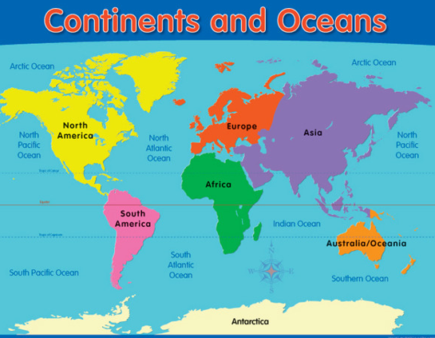
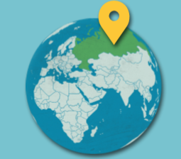
Survival
Geography Unit: Russia and the Wider World
Autumn 1
Year 6
Core Learning of this unit: Children locate the world’s countries on a map, researching and identifying key physical and human characteristics and major cities with a focus on Russia. Children further their locational knowledge through the accurate use of maps, atlases, globes and digital/computer mapping. Use the eight points of a compass, four and six-ﬁgure grid references, symbols and key (including the use of Ordnance Survey maps) to build their knowledge of Russia.
Vocabulary | Definition
Biomes | a large naturally occurring community of flora and fauna occupying a major habitat
Flora | the plants of a particular region
Fauna | the animals of a particular region
Coniferous | producing cones, and having leaves that do not fall off in the winter
Deciduous | A tree/shrub shedding its leaves annually
Latitude | the distance north or south of the equator measured in degrees
Longitude | distance measured in degrees east or west of an imaginary line that runs from the north pole to the south pole and passes through Greenwich, England
Hemisphere | a half of the earth, divided into northern and southern halves by the equator
Economy | the state of a country or region in terms of the production and consumption of goods and services and the supply of money.
Trade | the action of buying and selling goods and services
Key Facts
Russia (official name: Russian Federation) is the world’s largest country (with an area of 17,075, 200 square kilometres) and has a population of 144, 125, 000.
The currency of Russia is the Ruble.
The capital city of Russia is Moscow. It has a population 13.2 million people within the city limits and 17 million within the urban areas. It is situated on the Moskva River in western Russia.
BRICS is an acronym for the grouping of the world’s leading emerging economies, namely Brazil, Russia, India, China and South Africa.
Prior Learning
Year 2 Year 4 Year 5
Explorers Passport to Europe Amazon Rainforest

