Slide 1
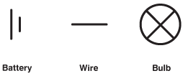
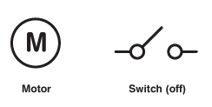
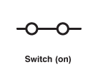
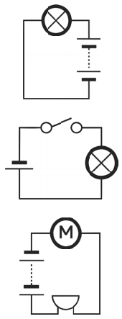
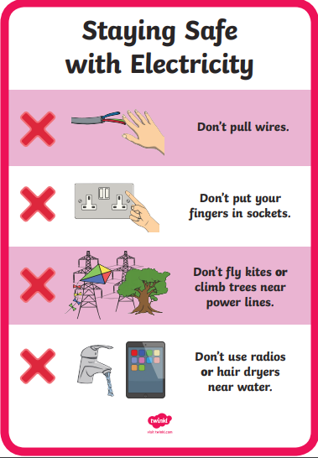
Electricity
Year 4
Key Facts
Electricity is a type of energy which can be used to power household items like toasters, tvs, kettles, play stations, fridges and washing machines.
Electricity can be found in a mains or battery. Mains need plugging into a socket and battery’s have stored electricity which can be put into electrical items. These can sometimes be charged.
Electricity is made by electrons (particles in an atom) moving around in a current.
For electricity to work it needs to be in a circuit. If the circuit is broken, it will not work.
The battery, or cell, has a positive and negative side, they must always have opposite sides facing.
Switches can be made using conductors. Switches break an electrical circuit.
Some objects conduct electricity; this means they allow electricity to flow through them easily. These are called conductors.
Other objects do not allow electricity to flow through them easily, these are called insulators.
Key Vocabulary
Component | A single item that can be connected together to make an electrical circuit.
Cell (Battery) | A container consisting of one or more cells which chemical energy is converted into electricity and used as a source of power.
Wire | A length of wire used to carry an electrical current.
Buzzer | An electrical device that makes a buzzing sound.
Motor | An electrical device that moves.
Switch | A device for making and breaking the connection in an electric circuit.
Circuit | A system of electrical conductors and components forming an electrical circuit.
Connection | Linking together.
Break | Separate into parts.
Device | Something made for a special purpose.
Appliance | A device of piece of equipment designed to perform a specific task.
Safety | Freedom from danger or harm.
Conductor | Allows an electric current to flow.
Insulator | Doesn’t allow electricity to flow.
Working Scientifically
By observing patterns like making bulbs brighter by adding more cells or exploring the conductors of electricity.
Links in the Curriculum:
Year 6 – Electrical circuits

