Slide 1
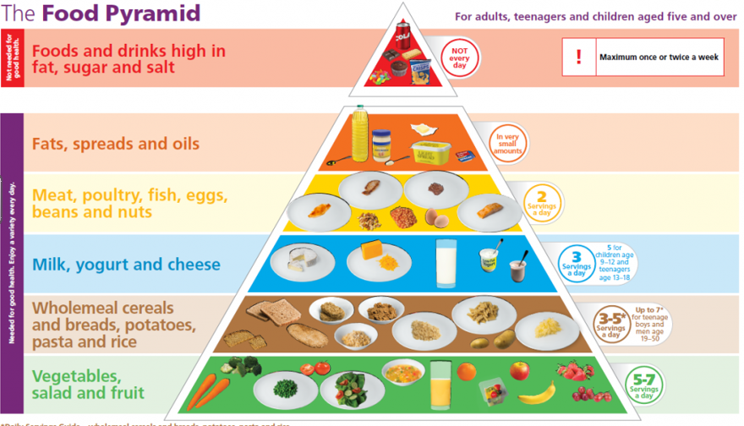
Year 2 Science Knowledge Organiser - Fighting Fit (Autumn Term 2)
Vocabulary
Survival
Basic need
Growth
Hygiene
Medicine
Nutrition
Balanced diet
Describe
Differences
Observe
Definition
To continue to live or exist.
The absolute minimum things needed for long term well being.
The process of increasing in size.
An activity that you do to keep things healthy and clean.
A drug or something similar used to treat illnesses or prevent disease.
Having the necessary food for health and growth.
A diet made up different types of food that give your body the right amounts of nutrients.
To give a detailed account in words.
The way in which people or things are dissimilar (not the same).
To watch carefully the way something happens.
Key Knowledge
All humans have the same basic needs for survival (water, food and air).
Humans have offspring which grow into adults.
Exercise, eating the right amounts of different types of food and hygiene are important in keeping us healthy.
For a balanced diet, our bodies need carbohydrates, protein, fat, fibre, vitamins, minerals and water, in the right amount.
When we become ill we may need to take some medicine (drugs) to make us better.
Links to other years
Every year group has a focus on the human body. Year 1 – Senses; Year 2- How humans keep healthy; Year 3 - Where humans get their nutrition & the skeleton; Year 4 -The digestive system; Year 5 –Changes as we get older; Year 6 - The human circulatory system; the functions of the heart, blood and blood vessels; keeping healthy and nutrients; and the eye.
WOW....
To make a healthy snack (pizza).

