Slide 1
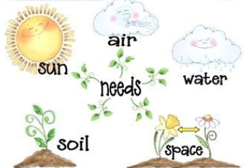
PLANT growth - Science
Year 2 spring term 2
Key Vocabulary
Bulbs | A short stem with fleshy leaves that function as food storage during dormancy (over the winter).
Seedling | A young plant, especially one raised from seed and not from a cutting.
Seeds | Part of the flowering plant, capable of developing into another such plant.
Shoot | A young branch or sucker springing from a tree or plant.
Grow/ Growth | To be able to grow in some place or situation / The process of increasing in size.
Earth | Material made up from part of the surface of the Earth.
Soil | The loose upper layer of the Earth’s surface where plants grow. It is made up of a mixture of decayed plants and animals and broken bits of rocks and minerals.
Wither | When a plant becomes dry and shrivelled.
Limp | Lacking strength, not stiff or firm.
Light | “The light of the sun”: A natural agent that stimulates sight and makes things visible.
Key learning
Plants: Plant Growth
Observe and describe how seeds and bulbs grow into
mature plants.
Find out and describe how plants need water, light and a
suitable temperature to grow and stay healthy.
Understand how changing the above affects the plant.
Understand that plants are living and eventually die.
Working Scientifically:
Observe and record the growth of plants as they change
over time from a seed or bulb.
Observe similar plants at different stages of growth.
Set up a comparative test to show that plants need light
and water to stay healthy.
Observe through observation and measurement, how
humans grow.
Record findings using charts.
Ask questions about what humans need to stay healthy.
Suggest ways to find answers to questions.
A plant is a living organism.
Plants help humans and animals to live by providing food to eat and oxygen to breathe.
Most plants grow from a seed or bulb.
Seeds and bulbs need water and a suitable temperature to grow.
Seeds and bulbs get their food from a store inside of them.
When a seed starts to grow into a plant, a stem appears above the soil.
Plants need the right conditions to grow.
They need water, light, nutrients, a suitable temperature, air and time.
A plant may die if it doesn’t have enough of these things.
Plants - Key facts
Working scientifically: | Describe, Different/differences Notice patterns Observe Observe changes over time Similar / similarities
Making comparisons: | Tall/ taller/ tallest Long/ longer/ longest/ Like/ similar to
Links in the Curriculum:
Year 1: Plants (parts of a plant and identifying some different plants and trees).
Year 3: Plants (needs of the plant and function of each part. How water travels around the plant).
Year 5 (plant reproduction, including seed dispersal and pollination. Photosynthesis).

