Slide 1
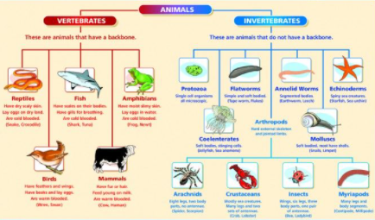
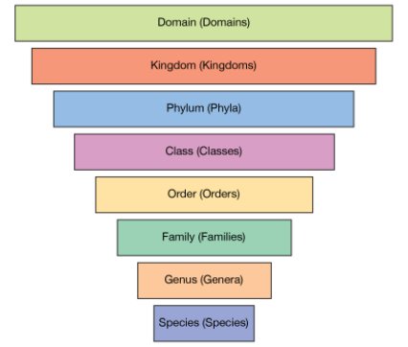
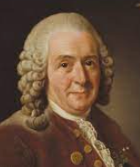
Science Unit
Living Things and Their Habitats
Classification
Summer 2
Year 6
Key Vocabulary
Classification | grouping something according to shared qualities or characteristics.
Amphibian | cold-blooded vertebrates that don’t have scales.
Microorganisms | Organisms (living thing) that are incredible small including bacteria, fungi and viruses.
Fungus | A living organism (yeasts, moulds and mushrooms) that are a separate kingdom of living things.
Vertebrate | An animal with a backbone
Invertebrate | An animal without a backbone.
Mollusc | an invertebrate which includes snails, slugs, mussels and octopuses, that have a soft unsegmented body and often a shell.
Taxonomy | The science of naming, describing and classifying organisms: plants, animals and microorganisms.
Mammals | A warm-blooded vertebrate with hair that feed their young with milk.
Reptiles | A vertebrate with dry scaly skin that typically lay soft-shelled eggs on land.
Arachnid | a group of arthropods that include spiders, ticks, mites, scorpions and harvestmen.
Crustacean | a group of marine life that includes crabs, lobsters, and shrimp.
Core Learning of this unit: To describe how living things are classified into broad groups according to common observable characteristics and based on similarities and differences, including micro-organisms, plants and animals. To give reasons for classifying plants and animals based on specific characteristics. Living things can be grouped into micro-organisms, plants and animals. Vertebrates can be grouped as fish, amphibians, reptiles, birds and mammals. Invertebrates can be grouped as snails and slugs, worms, spiders and insects. Plants can be grouped as flowering plants (incl. trees and grasses) and non-flowering plants (such as ferns and mosses).
Working Scientifically
Use classification systems and keys.
Identifying [grouping and classifying] some animals and plants in the immediate environment.
Research unfamiliar animals & plants from a broad range of other habitats & decide where they belong in the classification system [grouping and classifying].
Prior Learning:
Year 2 –Living Things and their habitats (Wind in the Willows)
Year 4- Living Things and their Habitats (Hunted)
Significant People Carolus Linnaeus was a Swedish naturalist. He created two scientific systems: the system for classifying plants and animals and the system for naming all living things. His method is still used today.

