Slide 1
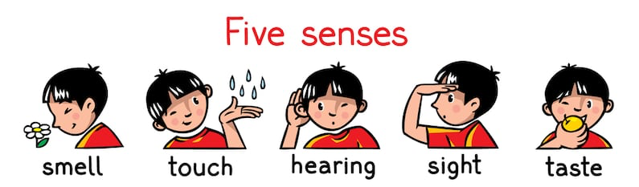
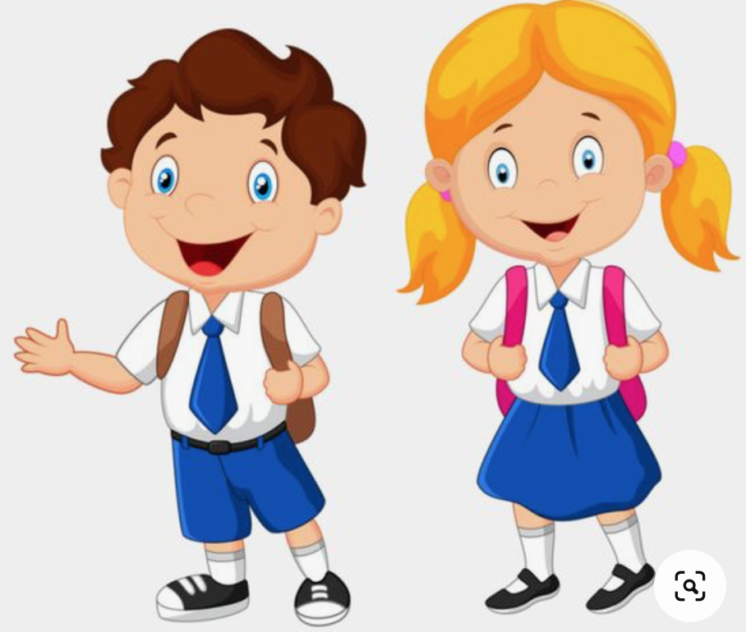
Year 1
Robots - humans
We have five senses:
We smell using our nose.
We taste using our tongue.
We touch using parts of our body, like our hands.
We see using our eyes.
We hear using our ears.
Core Learning of this unit
The different parts of the body.
Nose – helps us to smell.
Eyebrows – these protect our eyes.
Hair – this grows on our head and helps to protect our skull. The skull is the bone that protects our brain.
Eyes – these help us to see.
Neck – connects the head to the rest of the body.
Ears - these help us hear.
Shoulders – these helps us life our arms.
Mouth – we use our mouth to eat and talk. Inside our mouths are tongues which help us to taste and teeth to help us chew.
Hands – these help us grab things and write.
Elbows – these help our arms to bend.
Feet – these help us stay balanced and upright.
Knees – these help us to bend our legs.
Prior Learning & Curriculum links
Working Scientifically
Prior learning
Foundation Stage: Understanding of the world.
Know how to keep healthy by doing exercise and eating healthily.
Know some rhymes about the body (e.g. Head, shoulder, knees and toes.)
Label the different parts of the body and describe what each part does.
Draw around one of the pupils in your class using chalk – label the different parts of the body.
Complete a simple investigation – do people with bigger feet have bigger hands?
Participate in sensory experience where you taste, feel, look at and see different food.
Use sense to compare different textures, sounds and smells.
Discuss activities where you might not have all your senses.

