Slide 1
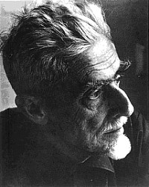
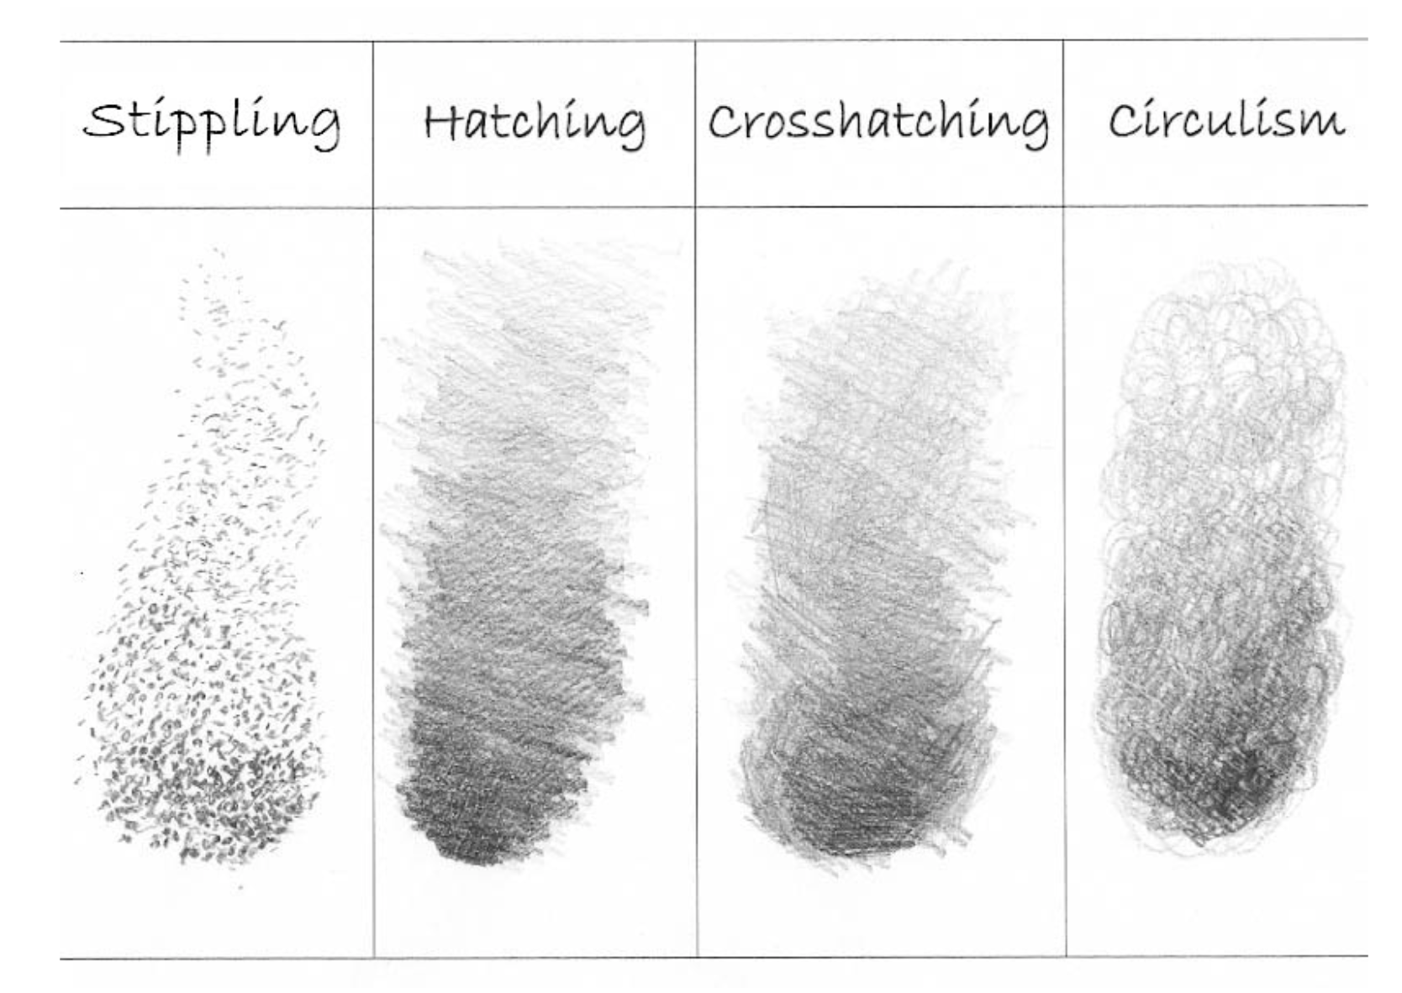
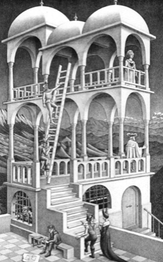
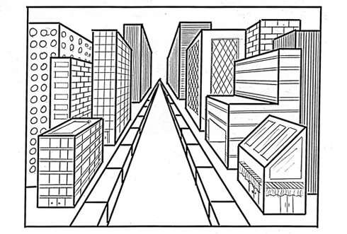
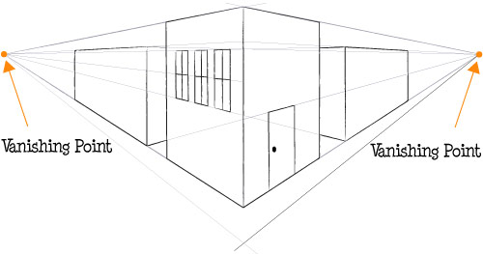
Perspective – Drawing and Digital Art
Year 6
Key Vocabulary
Perspective | The art of representing three-dimensional objects on a two-dimensional surface, so as to give the right impression of their height, width, depth, and position in relation to each other.
Vanishing Point | The point at which receding parallel lines viewed in perspective appear to converge.
Cross-Hatching | Shading with intersecting sets of parallel lines.
Hatching | Shading with closely drawn parallel lines.
Stippling | the art or process of drawing, painting, or engraving using numerous small dots or specks
Rectilinear | Constrained by, consisting of or moving in a straight line or lines.
Monochrome | A photograph or picture developed or executed in black and white or in varying tones of only one colour.
Maurits Cornelis Escher
.
M.C. Escher was born on June 17, 1898, in the Netherlands. He was known for being a graphic artist. His art was mathematically inspired .
Escher created many interesting works of art. He used mathematics in his pieces of art although he was not well-trained in the subject. He used black and white to create dimension. He used cubes, cones, spheres and spirals.
One-Point Perspective
Two-Point Perspective

