Slide 1
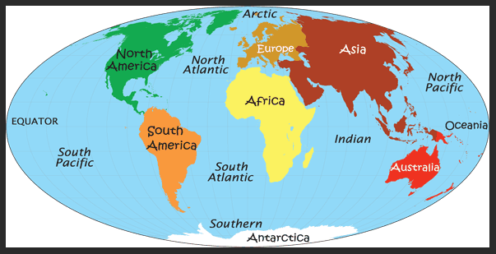
Explorers - Geography
Year 2 spring term 1
Key Vocabulary
Continent | A large area of continuous land on Earth.
Ocean | A huge body of salt water. There is one world ocean but it is divided up into 5 main areas.
Country | An area of land with its own government, occupying a particular territory.
Equator | An imaginary line around the middle of the Earth, halfway between the North Pole and South Pole. It divides the planet into a Northern and Southern Hemisphere.
Landmarks | A recognisable feature, often used for navigation. It stands out and can often be seen from long distances.
North Pole | The northernmost point on the Earth, lying diametrically opposite the South Pole.
South Pole | The southernmost point on the surface of Earth and lies on the opposite side of Earth from the North Pole.
Atlas | A collection of maps or charts of Earth or a region of Earth.
Globe | A spherical model of Earth. Similar purpose to a map, but it shows the surface 3d.
Map | Represents an area of land or sea, shows features.
Aerial view | Any view from a great height.
Physical features | Physical features show natural objects (mountains, deserts, rivers and oceans).
Human features | Something that was built by humans and would not have existed in nature without humans (houses, parks).
Key learning
Geographical Skills:
Name and locate the world’s continents and oceans.
Name and locate on a map a small area in a contrasting
non-European country.
Identify the location of hot and cold areas of the world in
relation to the Equator and the North and South Poles.
Use a range of maps and globes.
Recognise simple features on maps e.g. buildings, roads
and fields.
Recognise landmarks and basic human features on aerial
photos.
Use basic geographical vocabulary to refer to key physical
features and key human features.
Recognise differences between own and others’ lives.
Rwanda is a country in Central Africa.
It is one of the smallest countries on the African mainland.
It is located a few degrees south of the Equator.
Rwanda is landlocked (bordered by 4 other countries).
Key facts
There are 7 continents in the world. They are:
North America, South America, Europe, Asia, Australia, Africa and Antarctica.
Largest in area to smallest:
Asia, Africa, North America, South America, Antarctica, Europe and Australia.
There are 5 oceans in the world:
Pacific, Atlantic, Indian, Southern and
Arctic.
Biggest ocean to smallest:
Pacific, Atlantic, Indian, Arctic & Southern.
The weather around the North and South Poles is very cold and near the Equator it is very hot.
Non-European country - Rwanda
Map of the world showing the 7 continents and 5 oceans
Links in the Curriculum:
Year 1 – Continents
Year 2 – Continents & oceans
Year 5 – Continents, oceans

